Slide 1
Machine learning
Regent College London
SWE6204

Slide 2
Machine learning
SWE6204

Slide 3

Machine learning
NAÏVE BAYES TECHNIQUE

Slide 4
Learning objectives
Confusion Matrix
Making a classification syntax
Understand the Bayes theorem
Understand the how Naïve Bayes algorithm work
Application of Naïve Bayes
K-Folds and Cross validation
Examples using Python

Slide 5
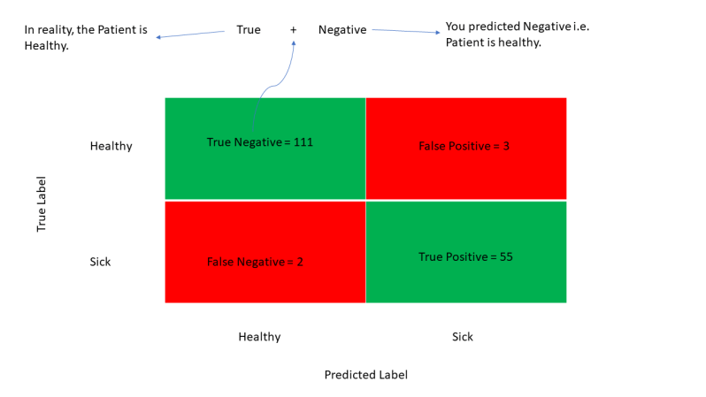
Confusion matrix
TP-True Positive cases when the classifier predicted TRUE (they have the disease) and the correct class was TRUE (patient has the disease)
TN-True Negative cases when the classifier predicted FALSE (no disease) and the correct class was FALSE (patient do not have the disease)
FP-False Positive cases when the classifier predicted TRUE , but the correct class was FALSE (Patient did not have the disease) –Type I Error
FN-False Negative classifier predicted FALSE (patient do not have disease) but they actually do have the disease-Type II Error
(BPRASAD.2022)
Notes:
Simple explanation :
Machine Learning Basics: Confusion Matrix & Precision/Recall Simplified | By Dr. Ry @Stemplicity
Professor Ryan
True Positives (TP) – True Positives occur when we predict an observation belongs to a certain class and the observation actually belongs to that class.
True Negatives (TN) – True Negatives occur when we predict an observation does not belong to a certain class and the observation actually does not belong to that class.
False Positives (FP) – False Positives occur when we predict an observation belongs to a certain class but the observation actually does not belong to that class. This type of error is called Type I error.
False Negatives (FN) – False Negatives occur when we predict an observation does not belong to a certain class but the observation actually belongs to that class. This is a very serious error and it is called Type II error.

Slide 6
Example of confusion matrix
Let us calculate the TP, TN, FP, and FN values for the class Setosa using the Above tricks:
TP: The actual value and predicted value should be the same. So, concerning Setosa class, the value of cell 1 is the TP value.
FN: The sum of values of corresponding rows except for the TP value
FN = (cell 2 + cell3) == (0 + 0)= 0
FP: The sum of values of the corresponding column except for the TP value.
FP = (cell 4 + cell 7)= (0 + 0)= 0
TN: The sum of values of all columns and rows except the values of that class that we are calculating the values for.
TN = (cell 5 + cell 6 + cell 8 + cell 9)= 17 + 1 +0 + 11= 29
Predicted Values
Actual Values |  | Setosa | Versicolor | Virginica
 | Setosa | 16 C1 | 0 C2 | 0 C3
 | Versicolor | 0 C4 | 17 C5 | 1 C6
 | Virginica | 0 C7 | 0 C8 | 11 C9

Slide 7
Naïve Bayes Classifier
It is a statistical classification technique based on Bayes Theorem
Supervised learning algorithm
It has high accuracy and speed on larger datasets
NBC assumes that effect of particular feature in a class is independent of other features.
For example, if a loan is applicable or not depends on income, previous loan, age etc. Even if these features are interdependent , these features are still considered independent.
This assumption simplifies computation and so it is considered as naïve and the assumption is called class conditional independence

Slide 8
Cont..
That is changing the value of one feature, does not directly influence or change the value of any of the other features used in the algorithm.
It really is a naive assumption to make about real-world data.
For example, if you use Naive Bayes for sentiment analysis, given the sentence ‘I like Harry Potter’, the algorithm will look at the individual words and not the full sentence. In a sentence, words that stand next to each other influence the meaning of each other, and the position of words in a sentence is also important. However, for the algorithm, phrases like ‘I like Harry Potter’, Harry Potter like I’, and ‘Potter I like Harry’ are the same.

Slide 9
Advantages & Disadvantage of naïve bayes
Turns out that the algorithm is able to effectively solve many complex problems. For example, building a text classifier with Naive Bayes is much easier than with more hyped algorithms such as neural networks.
The model works well even with insufficient or mislabeled data, so you don’t have to ‘feed’ it hundreds of thousands of examples before you can get something reasonable out of it.
Even if Naive Bayes can take as much as 50 lines, it is very effective.
It performs better with categorical than with numerical values.
It automatically assumes the bell curve distribution, which is not always right.

Slide 10
Where is naïve bayes used
Document classification. This algorithm can help you to determine to which category a given document belongs. It can be used to classify texts into different languages, genres, or topics (through the presence of keywords).
Spam filtering. Naive Bayes easily sorts out spam using keywords. For example, in spam, you can see the word ‘hmrc-tax-refund’ much more often than in regular mail. The algorithm must be trained to recognize such probabilities and, then, it can efficiently apply them for spam filtering.
Sentiment analysis. Based on what emotions the words in a text express, Naive Bayes can calculate the probability of it being positive or negative. For example, in customer reviews, ‘good’ or ‘inexpensive’ usually mean that the customer is satisfied. However, Naive Bayes is not sensitive to sarcasm.
Image classification. For personal and research purposes, it is easy to build a Naive Bayesian classifier. It can be trained to recognize hand-written digits or put images into categories through supervised machine learning.

Slide 11
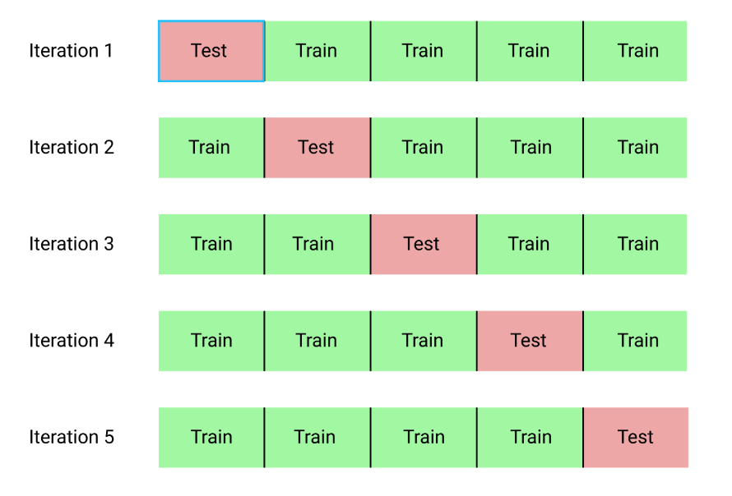
K-fold Cross Validation
In train-test split you're a setting aside a chunk of your data, so you won't be able to use it to train your algorithm.
Also data is sampled at random, it has a chance of being skewed in some way, not representing the whole dataset properly.
K-fold cross validation addresses these problems.
First split the data into several (10 for example, if k = 10) subsets, called folds.
Then you train and evaluate your model 10 times, setting aside each one of the folds in turn, and training the model on the remaining 9 folds
K-fold cross-validation can be used to select the best model among a set of candidate models.

Slide 12
Using python
Example Using Naïve Bayes Classifier by K-Fold and validating by Cross_val_score()
See the Practical Implementation

Slide 13
Introduction to probability
Weather conditions and playing sports. You need to calculate the probability of playing sports. So, to classify whether players will play or not.
Prior and posterior probability calculation, can use the frequency and the likelihood tables.
Frequency table contains the occurrence of labels for all features
These are likelihood tables.
Notes:
Naive Bayes Classifier Tutorial: with Python Scikit-learn | DataCamp

Slide 14

Bayes theorem
Bayes' Theorem is a mathematical formula used to determine the conditional probability of an event, based on prior knowledge of conditions that might be related to the event. It allows for the updating of probability estimates as new evidence is presented.
Where:
𝑃(𝐴∣𝐵) is the probability of event A occurring given that B is true.
𝑃(𝐵∣𝐴) is the probability of event B occurring given that A is true.
𝑃(𝐴) and 𝑃(𝐵) are the probabilities of events A and B independently of each other.
https://www.youtube.com/watch?v=vz_xuxYS2PM

Slide 15
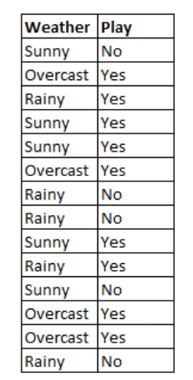
How naïve Bayes algorithm works?
Let’s understand it using an example. Below I have a training data set of weather and corresponding target variable ‘Play’ (suggesting possibilities of playing). Now, we need to classify whether players will play or not based on weather condition. Let’s follow the below steps to perform it.
Step 1 - Convert the data set into a frequency table
Step 2 - Create Likelihood table by finding the probabilities

Slide 16
Frequency table
 | Frequnecy Table
Weather | No | Yes
Overcast
Rainy
Sunny
Total

Slide 17
Likelihood table
 | Likelyhood Table
Weather | No | Yes
Overcast |  | 4 | 0.29
Rainy | 3 | 2 | 0.36
Sunny | 2 | 3 | 0.36
Total | 5 | 9
 | 0.36 | 0.64

Slide 18
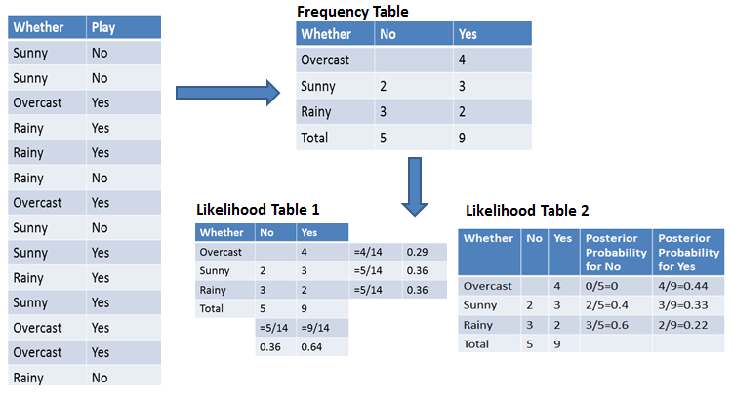
Naïve bayes technique

Slide 19
Probabilty
P(Yes|Overcast) ?
Probability of playing:
P(Yes | Overcast) = P(Overcast | Yes) P(Yes) / P (Overcast) .....................(1)
Calculate Prior Probabilities:
P(Overcast) = 4/14 = 0.29
P(Yes)= 9/14 = 0.64
Calculate Posterior Probabilities:
P(Overcast |Yes) = 4/9 = 0.44
Put Prior and Posterior probabilities in equation (1)
P (Yes | Overcast) = 0.44 * 0.64 / 0.29 = 0.98(Higher)
Notes:
Probability of playing:
P(Yes | Overcast) = P(Overcast | Yes) P(Yes) / P (Overcast) .....................(1)
Calculate Prior Probabilities:
P(Overcast) = 4/14 = 0.29
P(Yes)= 9/14 = 0.64
Calculate Posterior Probabilities:
P(Overcast |Yes) = 4/9 = 0.44
Put Prior and Posterior probabilities in equation (1)
P (Yes | Overcast) = 0.44 * 0.64 / 0.29 = 0.98(Higher)

Slide 20
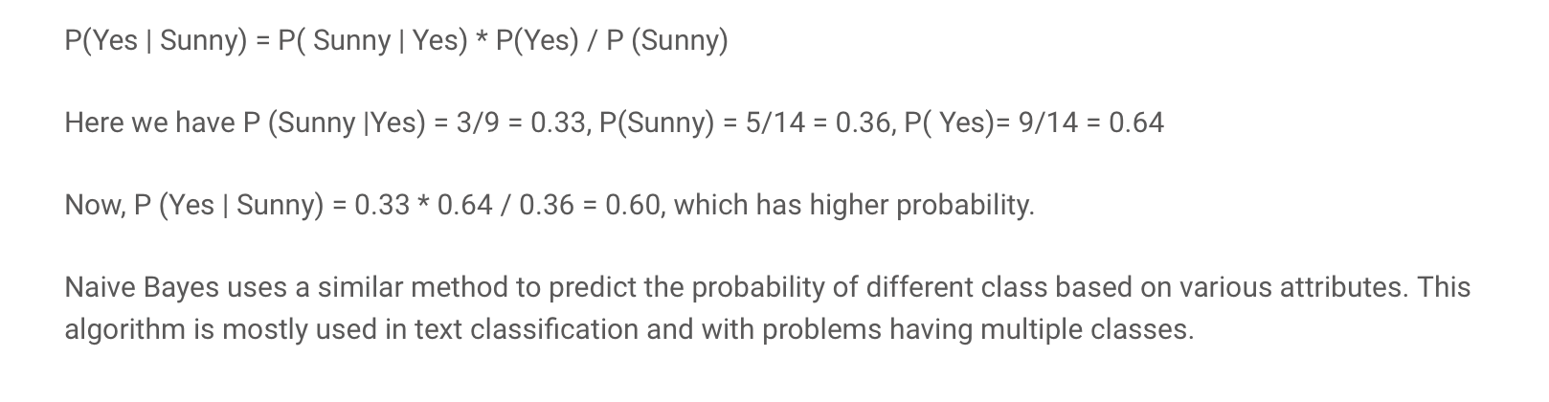
example

Slide 21
reference
Gavrilova,Y.2021. Naive Bayes Algorithm for Beginners.[Online].Available at: https://serokell.io/blog/naive-bayes-classifiers
Navlani, A. & Awan, A. A., 2023. Naive Bayes Classification Tutorial using Scikit-learn. [Online].Available at: https://www.datacamp.com/tutorial/naive-bayes-scikit-learn
Simplilearn. 2018.Learn how to build and evaluate a Naive Bayes Classifier using Python's Scikit-learn package .[Online].Available at: https://www.youtube.com/watch?v=l3dZ6ZNFjo0
Digitalmind.2022. Train-test split and cross-validation.[Online].Available at: https://digitalmind.io/post/train-test-split-and-cross-validation
Digitalmind.2022.Saving Machine Learning Models.[Online].Available at: https://digitalmind.io/post/saving-machine-learning-models#saving-machine-learning-models
Singh,Y.2022.How to Generate Datasets Using make_classification .[Online].Available at: https://proclusacademy.com/blog/sklearn_make_classification/
KHALUSOVA,M.2022. MACHINE LEARNING MODEL EVALUATION METRICS PART 2: MULTI-CLASS CLASSIFICATION. .[Online].Available at: https://www.mariakhalusova.com/posts/2019-04-17-ml-model-evaluation-metrics-p2/
Sim,N.2021.Understanding Multi-class Classification Confusion Matrix in Python..[Online].Available at: https://nicoleeesim97.medium.com/understanding-multi-class-classification-confusion-matrix-in-python-8a45848ed28
Rashida.2022.Learn Precision, Recall, and F1 Score of Multiclass Classification in Depth .[Online].Available at:.https://regenerativetoday.com/learn-precision-recall-and-f1-score-of-multiclass-classification-in-depth/
BPRASAD.2022.Confusion Matrix – How to plot and Interpret Confusion Matrix.[Online].Available at: https://lifewithdata.com/2022/02/06/confusion-matrix-how-to-plot-and-interpret-confusion-matrix/

Slide 22
reference
investopedia.com - Bayes' Theorem: What It Is, Formula, and Examples
wikipedia.org - Bayes' theorem
plato.stanford.edu - Bayes' Theorem
corporatefinanceinstitute.com - Bayes' Theorem - Definition, Formula, and Example
mathsisfun.com - Bayes' Theorem
byjus.com - Bayes Theorem - Statement, Proof, Formula, Derivation & ...

Slide 23
+44 (0)207 016 8000
info@rcl.ac.uk

